Slide 1

Sparse & Redundant Representations and Their Applications in Signal and Image Processing Face Image Compression
Michael Elad
The Computer Science Department
The Technion – Israel Institute of technology
Haifa 32000, Israel

Slide 2
Compressing Face Images: Preliminaries

Slide 3

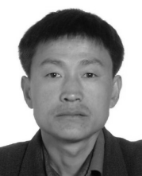

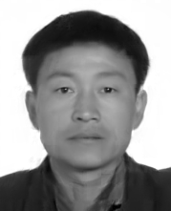
What is it All About?
K-SVD compression, 402 bytes, RMSE (6.27)
JPEG2000, 394 bytes, RMSE (16.76)
Michael Elad | The Computer-Science Department | The Technion

Slide 4
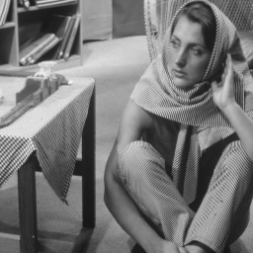
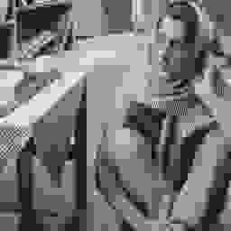
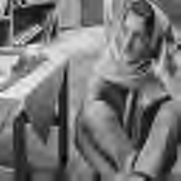
General Content Image Compression
Current standards (JPEG, JPEG-2000, and HEVC) are meant to serve general content images – this is their strength and this is also their weakness
JPEG, ~900 Bytes
JPEG2000, ~900 Bytes
Michael Elad | The Computer-Science Department | The Technion

Slide 5

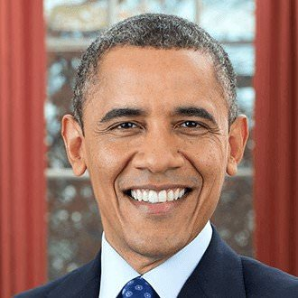
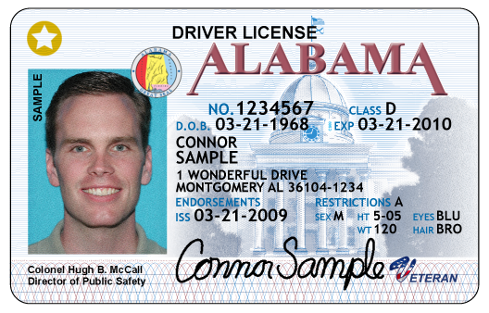


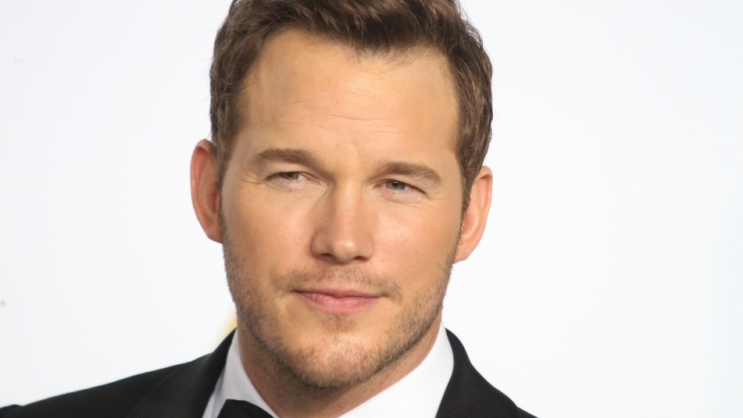
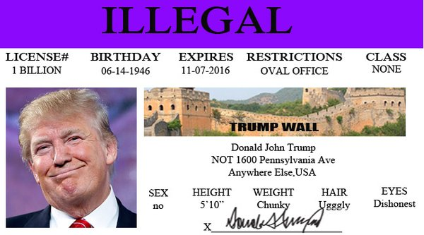
Face Images Are Everywhere
Michael Elad | The Computer-Science Department | The Technion

Slide 6
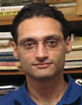
This Work
This presentation and the research behind it were created by Ori Bryt. This work is summarized in the following two papers:
O. Bryt and M. Elad, Compression of Facial Images Using the K-SVD Algorithm, Journal of Visual Communication and Image Representation, Vol. 19, No. 4, Pages 270-283, May 2008.
O. Bryt and M. Elad, Improving the K-SVD Facial Image Compression Using a Linear Deblocking Method, The IEEE 25-th Convention of Electrical and Electronics Engineers in Israel, Eilat Israel, December 3-5, 2008.
Ori Bryt
Michael Elad | The Computer-Science Department | The Technion

Slide 7
Our Goals
Compressing facial images as effective as possible
Very low bit-rates (compression ratio of ~100)
Maintaining image quality and clarity
Surpassing competing methods and standards
Side effect: Introducing sparse and redundant representations to image compression
Michael Elad | The Computer-Science Department | The Technion

Slide 8
Compression Face Images: Prior Work

Slide 9
Previous Work
Surprisingly, only few facial image compression algorithms are found in the literature
Coding techniques used:
Principle Component Analysis (PCA)
Independent Component Analysis (ICA)
Vector Quantization (VQ)
3D Tensors, &
Wavelets
The performance in these papers is similar to JPEG2000 (except the VQ option – see next)
Michael Elad | The Computer-Science Department | The Technion

Slide 10
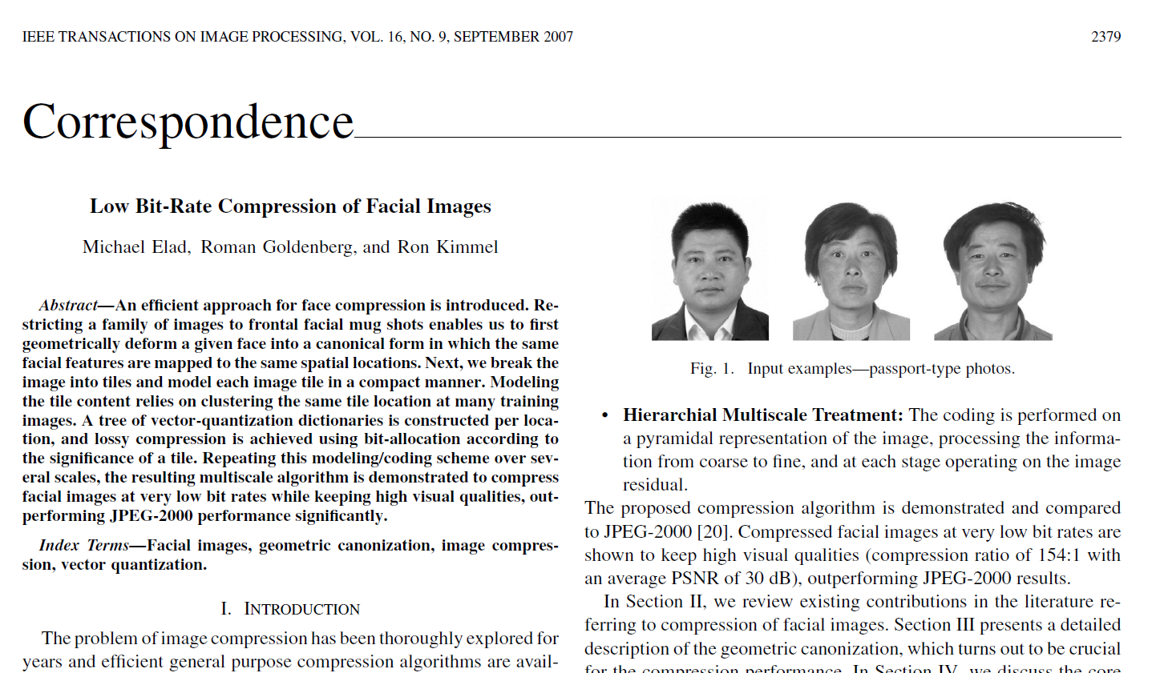
VQ-Based Algorithm [Elad, Goldenberg & Kimmel (’07)]
Image alignment – facial feature displacement
Coding in overlapping (one pixel) 8x8 patches
VQ codebooks obtained via Tree K-Means:
Each patch location: Independent codebook
Codebook size according to desired bit allocation
Multi-scale scheme with two grids, where the residual is coded in the fine grid
The proposed scheme is limited, and hard-coded to the test case explored
Michael Elad | The Computer-Science Department | The Technion

Slide 11
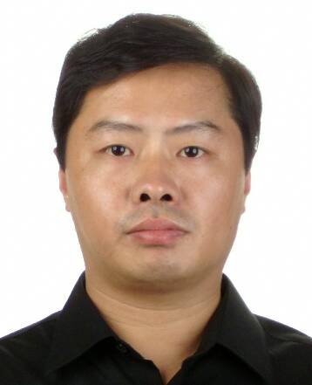
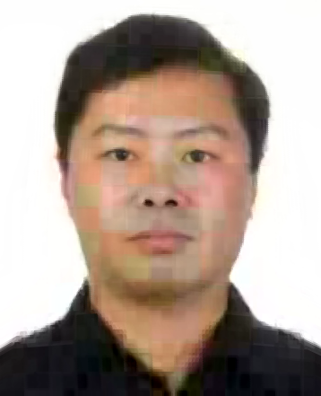
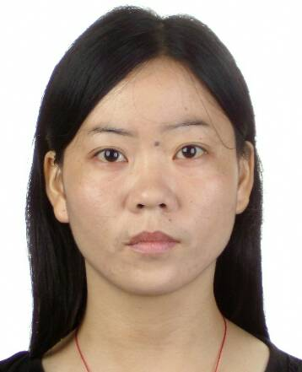
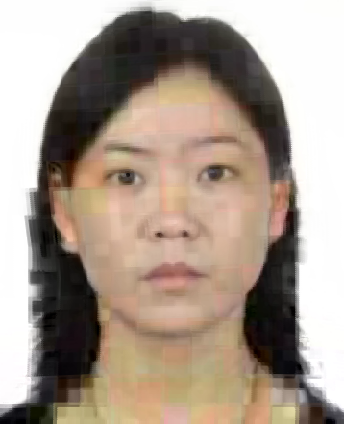
VQ-Based Algorithm [Elad, Goldenberg & Kimmel (’07)]
Defeats
JPEG2000
Original Image
RMSE (9.49)
Original Image
RMSE (15.18)
585 bytes
Michael Elad | The Computer-Science Department | The Technion

Slide 12
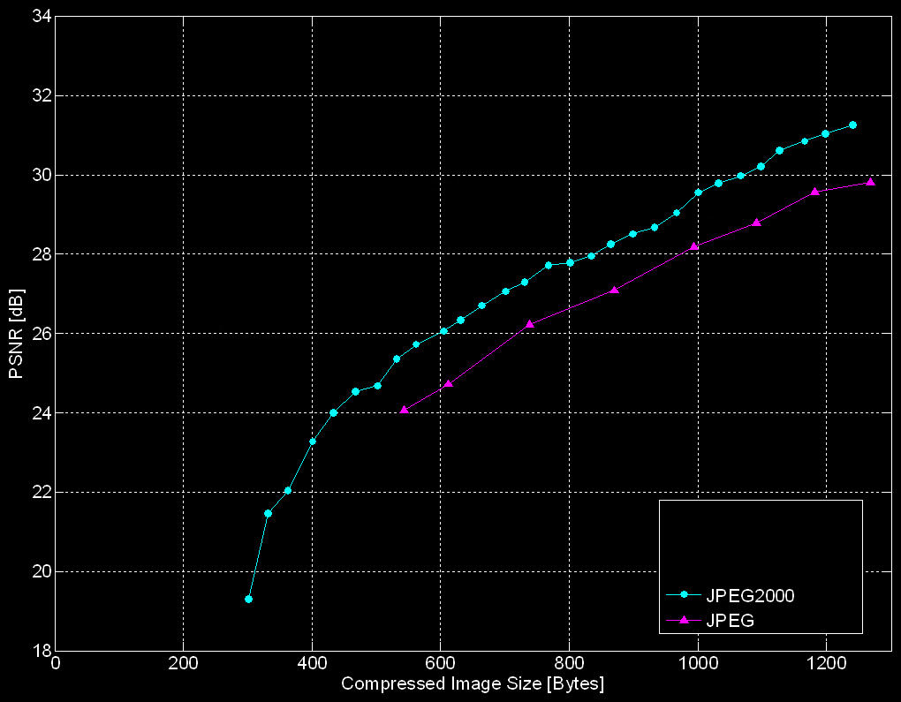
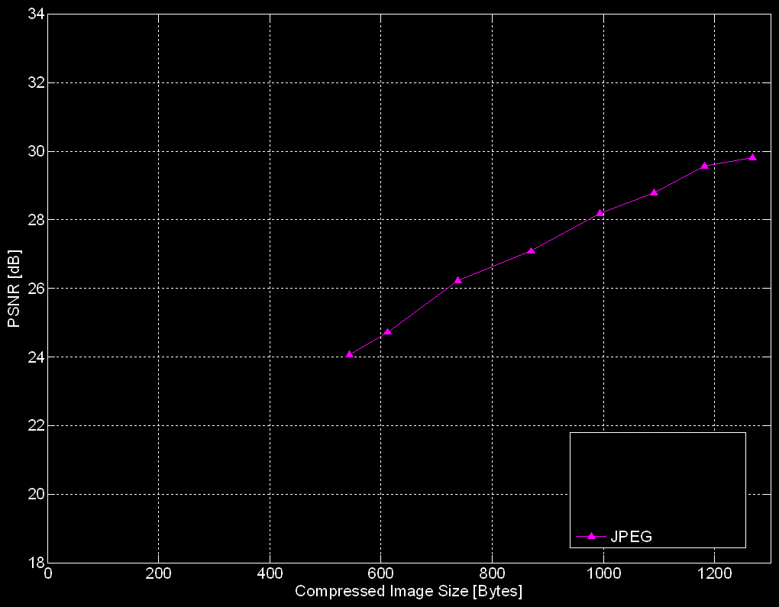
Performance Comparisons
Results averaged over 100 test images
JPEG
JPEG-2000
VQ-Based
Michael Elad | The Computer-Science Department | The Technion

Slide 13
Compression: VQ vs. Sparseland

Slide 14
Sparseland vs. Clustering
Notations:
B – overall budget of bits we have for the coding
P – the overall number of pixels in the image
N – number of samples in each patch
K – number of “atoms” in the dictionary
Using VQ:
Higher bit-rate ⇨ Either you have to increase K exponentially, or reduce N. Two bad choices …
Michael Elad | The Computer-Science Department | The Technion

Slide 15
Sparseland vs. Clustering
P=40000 (pixels)
P=40000 (pixels)
B=1000 Bytes
B=500 Bytes
√
Michael Elad | The Computer-Science Department | The Technion

Slide 16
Sparseland vs. Clustering
Notations: …
L – average number of non-zeros in a sparse representation
Q - number of bits in quantizing a non-zero coefficient
In Sparse and Redundant Representations:
Higher bit-rate is absorbed by L and Q, while keeping K and N to be of reasonable size
Michael Elad | The Computer-Science Department | The Technion

Slide 17
Sparseland vs. Clustering
P=40000;
sN=2:1:15;
figure(1); clf;
for B=500:100:1000
Bbits=B*8;
K=2.^(Bbits/P*sN.^2);
semilogy(sN,K); hold on;
end;
axis([2 15 1 1e5]);
xlabel('N [pixels]');
ylabel('K [Number of representation vectors]');
grid;
%===============================
P=40000;
K=512;
Q=7;
sN=8:1:30;
figure(1); clf;
for B=500:100:1000
Bbits=B*8;
L=Bbits/P/(log(K)/log(2)+Q).*sN.^2;
plot(sN,L); hold on;
end;
axis([8 30 0 12]);
xlabel('N [pixels]');
ylabel('L [Number of non-zeros]');
grid;
K=512 (atoms)
P=40000 (pixels)
Q=7 bits
B=1000 Bytes
B=500 Bytes
√
Michael Elad | The Computer-Science Department | The Technion

Slide 18
The Proposed Compression Scheme

Slide 19
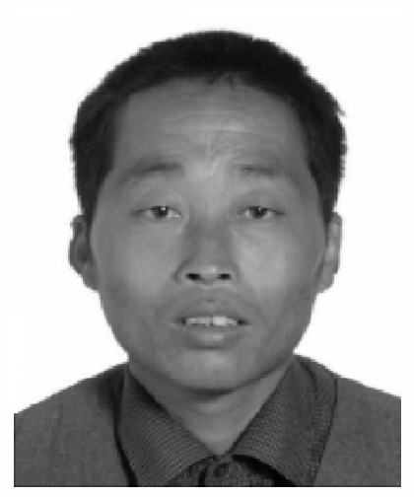
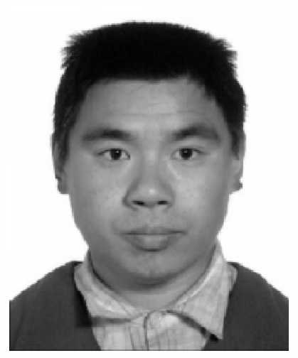
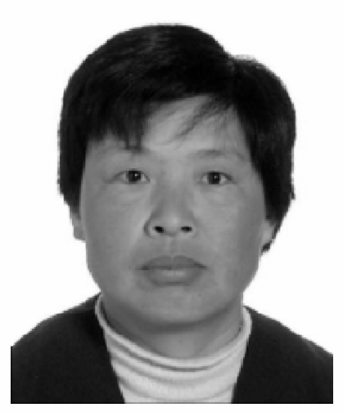
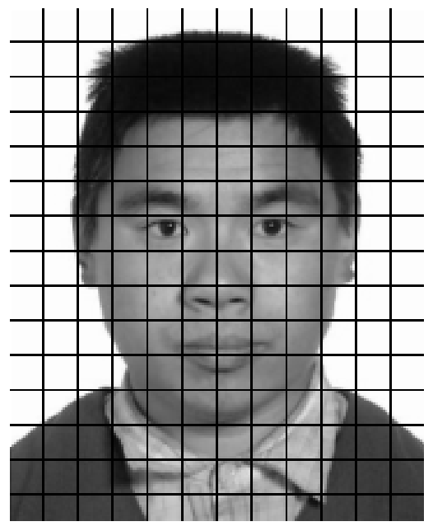
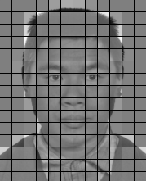
Pre-Processing
Alignment [Elad, Goldenberg & Kimmel (’07)]
13 Feature points
Triangulation
Affine warping
Division to patches
Mean patch removal
Each patch independently
Calculated over learning set
Michael Elad | The Computer-Science Department | The Technion

Slide 20
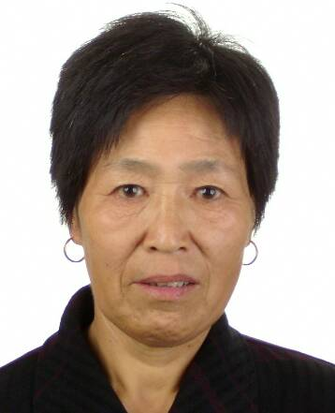
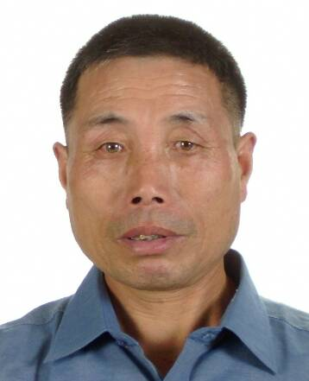
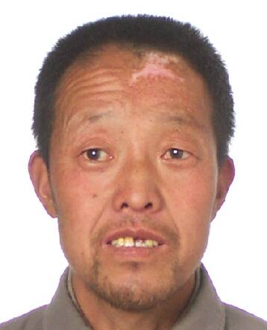
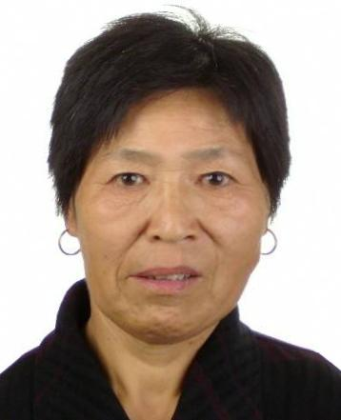
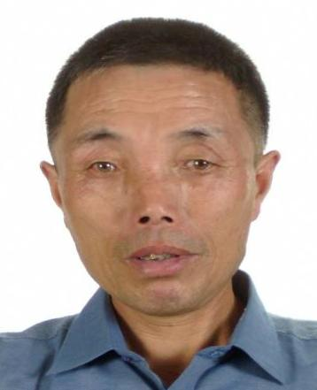
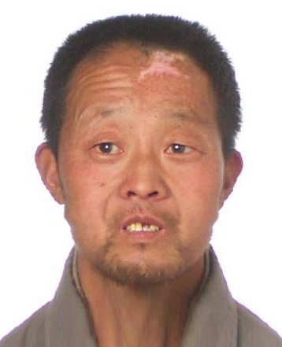
Image Alignment
Non-aligned Images
Aligned Images
Michael Elad | The Computer-Science Department | The Technion

Slide 21
Encoding
Each patch independently
Sparse coding
Matching K-SVD dictionary
Orthogonal Matching Pursuit
Coefficient allocation table
Atom indices and weights
A few for each patch
Michael Elad | The Computer-Science Department | The Technion

Slide 22

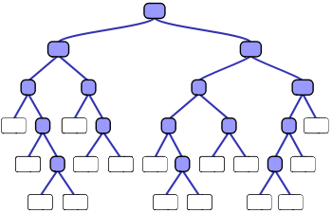
Encoding
Weight quantization
Uniform - obtained from learning set
Other schemes possible
Index entropy coding
Huffman coding – from learning set
Image alignment parameters
Alignment process is reversible
13 feature points coded to 20 bytes
Michael Elad | The Computer-Science Department | The Technion

Slide 23
Compressed Images Bit-Stream
73 001010
18 11010
52 0110010
5 0001100
53 101110
104 11101
28 0101010
90 11010
22 010111
62 11111
25 1010111
119 001010
51 000011
128 1100111
100 11101
75 010111
57 1001101
2 000100
66 11110
94 0110010
. .
. .
. .
Header (21 bytes)
Image alignment parameters (20 bytes)
Allocation table indicator (1 byte)
Coefficients
Ordered pairs of weights and indices
Coefficients are not separated
All other components known to both sides
Michael Elad | The Computer-Science Department | The Technion

Slide 24
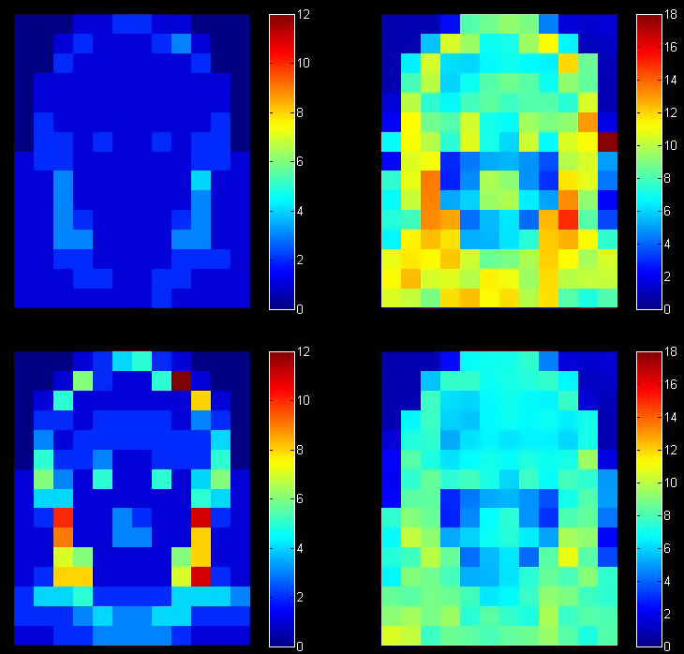
Coefficient Allocation
Error oriented
As bit-rate increases, complex patches require more coefficients
Simple patches do not change
Atom allocation, 400 bytes
Average error, 400 bytes
Atom allocation, 820 bytes
Average error, 820 bytes
Michael Elad | The Computer-Science Department | The Technion

Slide 25
Decoding
Coefficient allocation table
Defines how many non-zero per each patch
Required for decoding patches correctly
Calculated on learning set
Each reconstructed patch
Linear combination of chosen atoms with weights
Post-processing
Reverse application of pre-processing
Image deblocking
2 | 1 | 2 | 3 | 1
2 | 4 | 3 | 3 | 2
5 | 0 | 2 | 1 | 3
1 | 3 | 9 | 6 | 0
7 | 1 | 4 | 2 | 2
0 | 3 | 8 | 5 | 1
2 | 2 | 7 | 4 | 5
Header | C | C | C | C | C | C | C | C | C | …
Michael Elad | The Computer-Science Department | The Technion

Slide 26
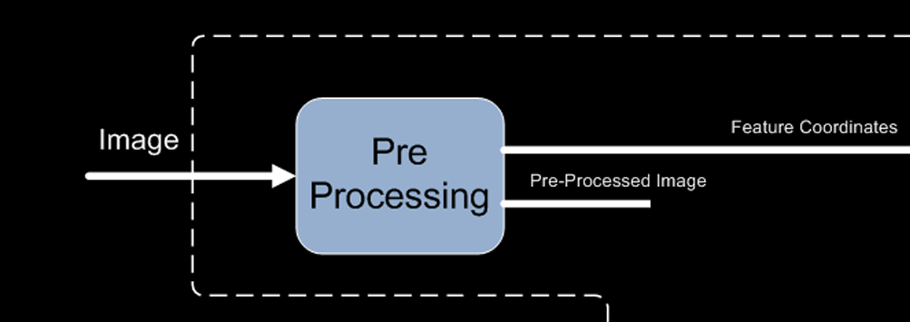
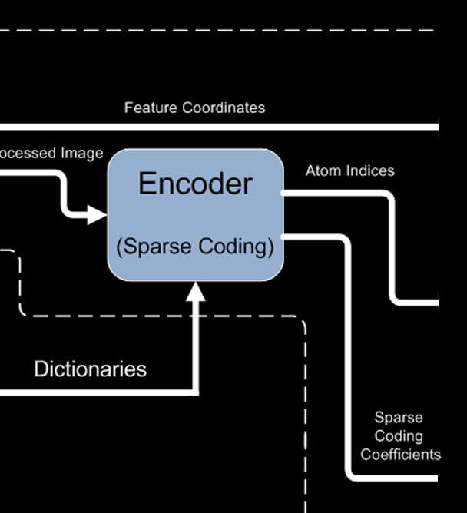
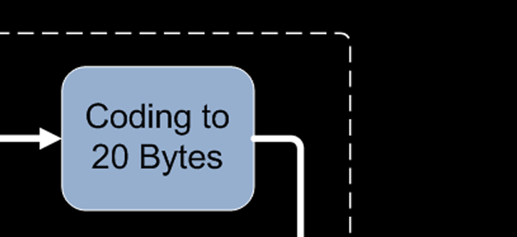
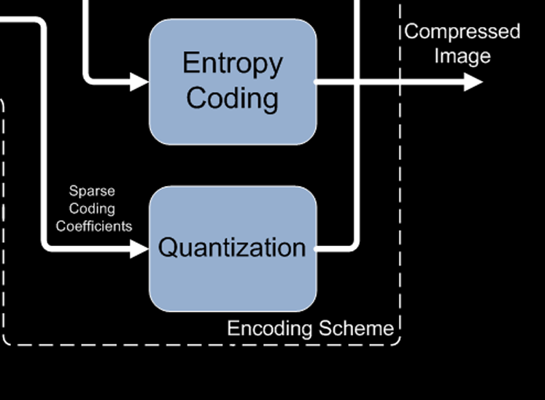
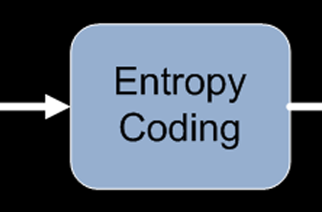
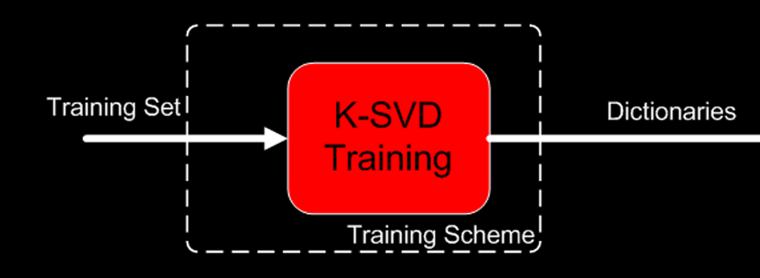
The Overall Compression Scheme: Encoder
Michael Elad | The Computer-Science Department | The Technion

Slide 27
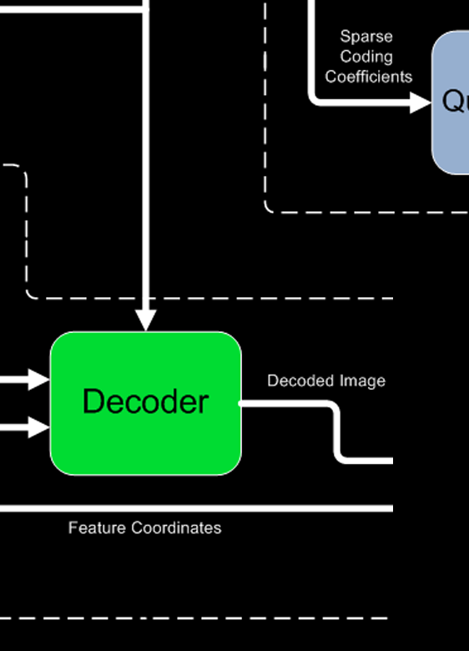
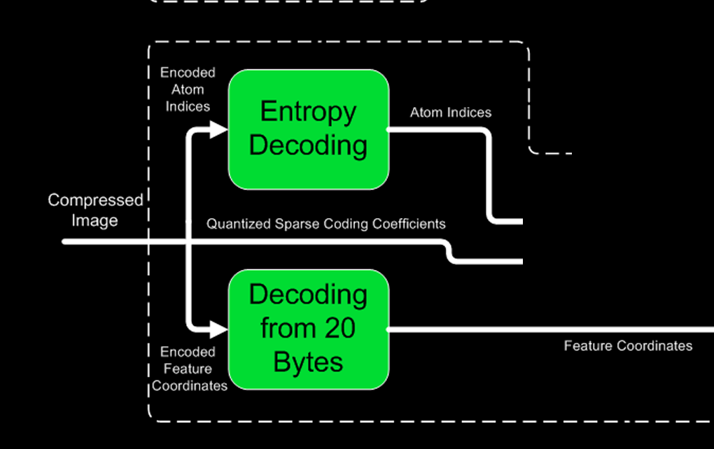
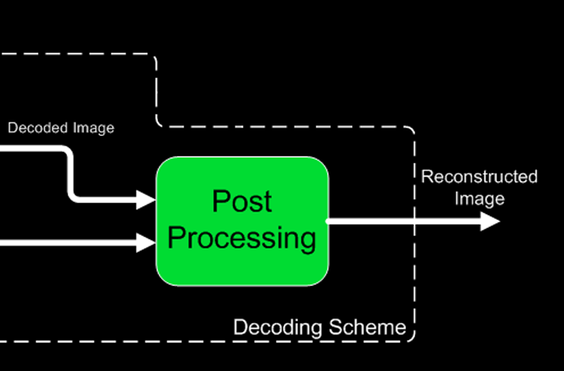
The Overall Compression Scheme: Decoder
Michael Elad | The Computer-Science Department | The Technion

Slide 28
Compression Results

Slide 29
Experiment’s Details
Image size: 221×179 pixels
4415 learning images, 100 test images
180 uniform patches of 15×15 pixels
A fixed number of 512 atoms in all the dictionaries
Maximum 20 coefficients per patch
7-bit uniform quantization per atom
Michael Elad | The Computer-Science Department | The Technion

Slide 30
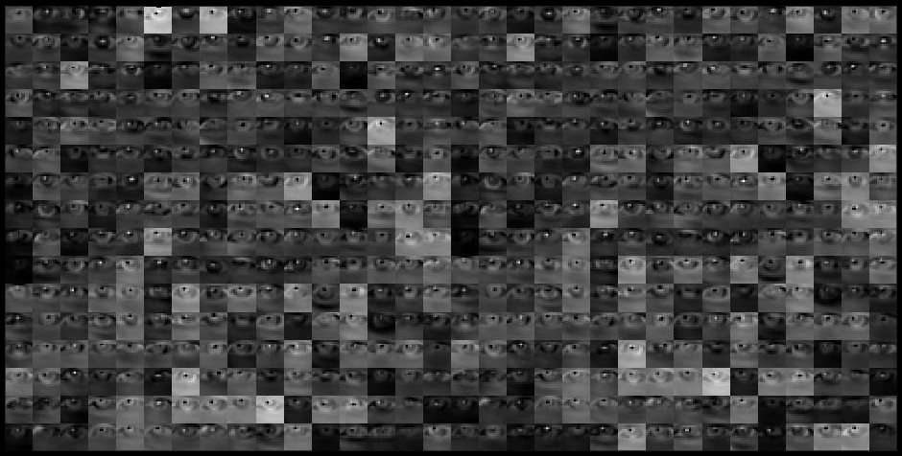
The Dictionaries Obtained
Training leads to adaptive K-SVD dictionaries
K-SVD Dictionary for the patch location of the left eye, using 4 coefficients
Michael Elad | The Computer-Science Department | The Technion

Slide 31
The Dictionaries Obtained
Dictionary size is important for performance
Small dictionary ⇨ Limited representation, but reduced # of bits
Large dictionary ⇨ Many bits for indices, but better representation
Finding the optimal size
Depends on patch size and learning set size
Depends on patch contents
Difficult to predict
Determined empirically
Michael Elad | The Computer-Science Department | The Technion

Slide 32
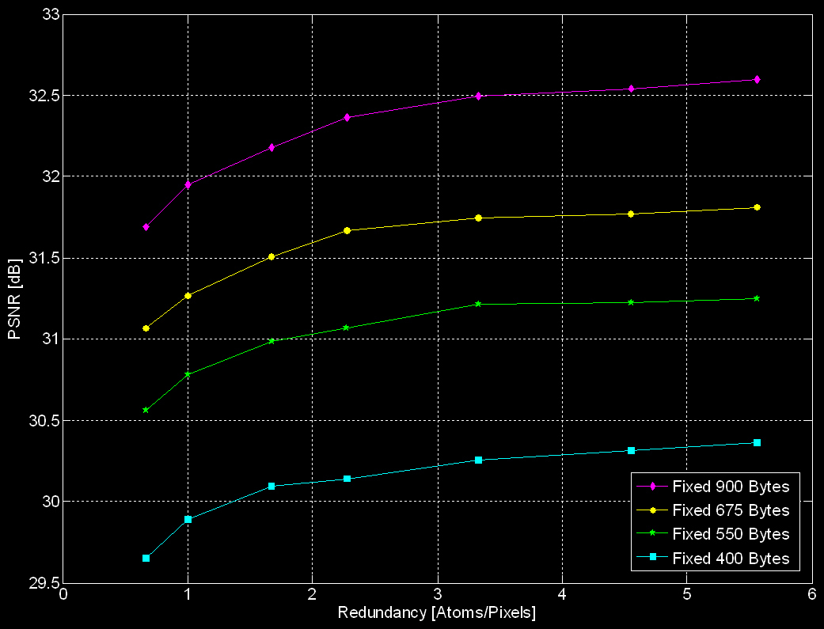
The Dictionaries Obtained
PSNR [dB]
Redundancy [Atoms/Pixels]
Michael Elad | The Computer-Science Department | The Technion

Slide 33
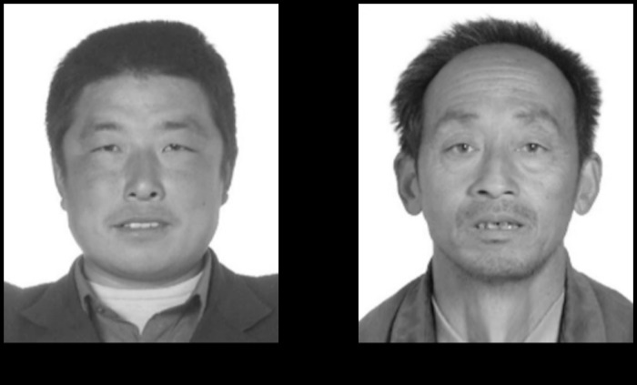
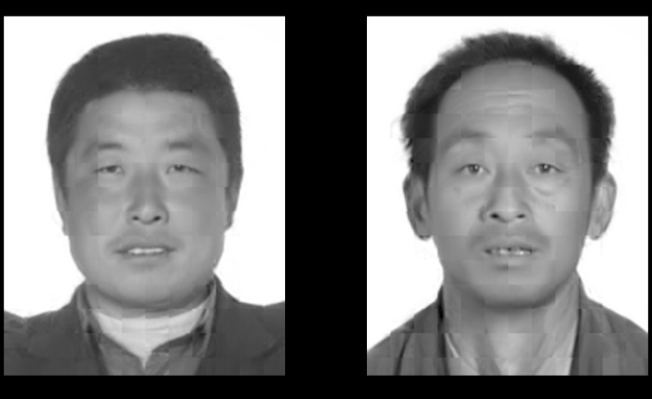
Results on the Training Set
630 bytes
Low error
Good visual quality
Artifacts:
Blockiness
Texture representation
Small facial details
High frequency elements
Original learning set images
RMSE (4.04) RMSE (5.9)
Michael Elad | The Computer-Science Department | The Technion

Slide 34
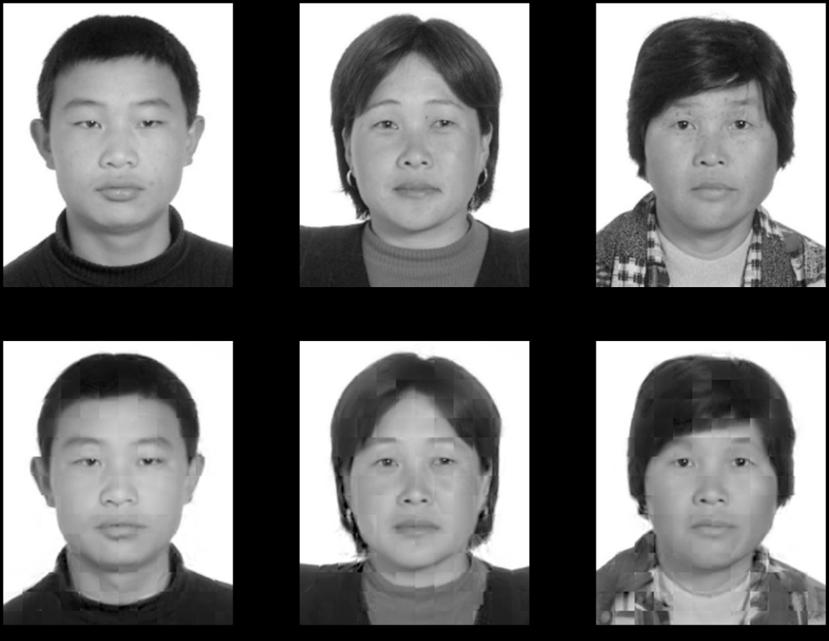
Results on the Test-Set
630 bytes
Low error
Good visual quality
Artifacts:
Blockiness
Texture representation
Small facial details
High frequency elements
Original Test Set Images
RMSE (5.3) RMSE (6.84) RMSE (11.2)
Michael Elad | The Computer-Science Department | The Technion

Slide 35
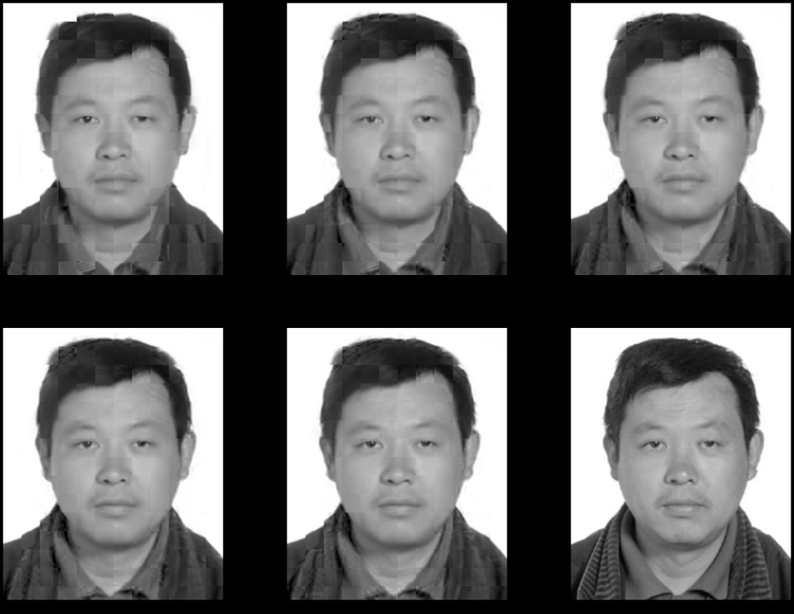
Bit-Rate Comparison
285 bytes (10.6) 459 bytes (8.27) 630 bytes (7.61)
820 bytes (7.11) 1021 bytes (6.8) Original
Michael Elad | The Computer-Science Department | The Technion

Slide 36
Performance Comparisons
Compared methods: JPEG, JPEG2000, PCA, K-SVD
Principle Components Analysis (PCA) method
Developed by us, as a very similar method
Dictionaries: eigenvectors of signals’ autocorrelation
Dictionary size according to targeted error
When coding, no need to send the indices
Compared targeted bit-rates: 400, 550 and 820 bytes
JPEG impractical at 400 bytes in our images
Michael Elad | The Computer-Science Department | The Technion

Slide 37
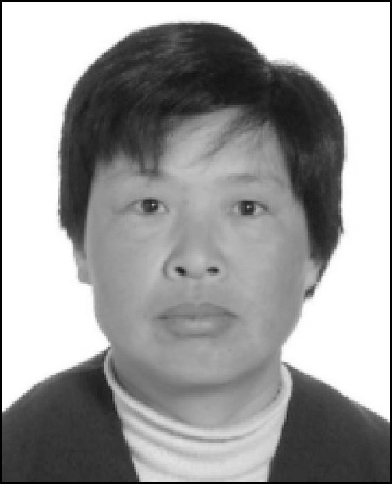
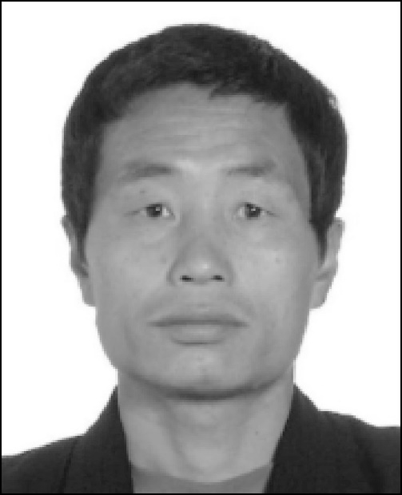
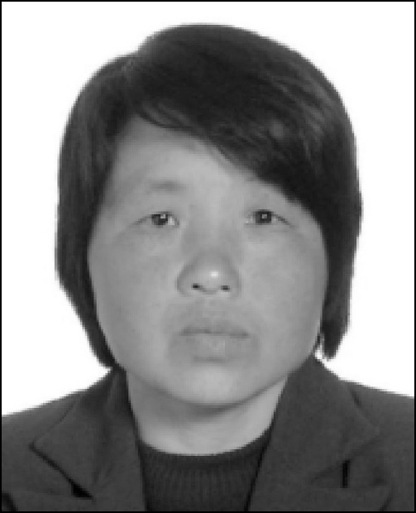
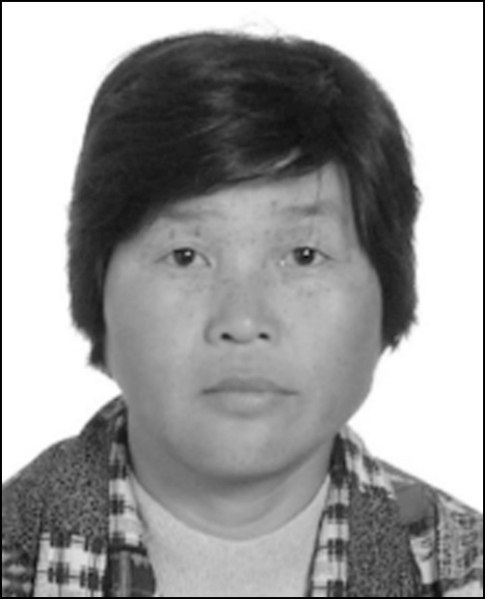
Performance Comparisons
Selected test images (comparisons w/o deblocking & warp)
Image 22
Image 25
Image 88
Image 92
Michael Elad | The Computer-Science Department | The Technion

Slide 38

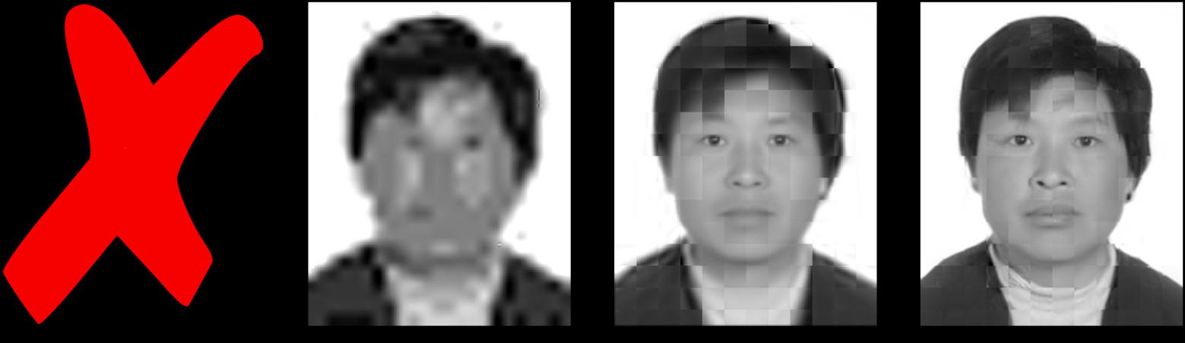
Performance Comparisons
400 Bytes
Image 22
JPEG JPEG2000 (17.85) PCA (12.52) K-SVD (7.9)
Michael Elad | The Computer-Science Department | The Technion

Slide 39

Performance Comparisons
550 Bytes
Image 22
JPEG (14.6) JPEG2000 (12.86) PCA (10.92) K-SVD (6.96)
Michael Elad | The Computer-Science Department | The Technion

Slide 40

Performance Comparisons
820 Bytes
Image 22
JPEG (11.09) JPEG2000 (9.03) PCA (9.11) K-SVD (5.95)
Michael Elad | The Computer-Science Department | The Technion

Slide 41




Performance Comparisons
400 Bytes
Image 25
JPEG JPEG2000 (15.31) PCA (11.43) K-SVD (6.37)
550 Bytes
JPEG (13.21) JPEG2000 (11.24) PCA (9.49) K-SVD (5.63)
820 Bytes
JPEG (10.36) JPEG2000 (7.9) PCA (7.98) K-SVD (4.94)
Michael Elad | The Computer-Science Department | The Technion

Slide 42




Performance Comparisons
400 Bytes
Image 88
JPEG JPEG2000 (16.07) PCA (12.55) K-SVD (7.24)
550 Bytes
JPEG (13.19) JPEG2000 (11.01) PCA (10.31) K-SVD (6.4)
820 Bytes
JPEG (10.53) JPEG2000 (7.63) PCA (8.65) K-SVD (5.63)
Michael Elad | The Computer-Science Department | The Technion

Slide 43




Performance Comparisons
400 Bytes
Image 92
JPEG JPEG2000 (20.07) PCA (17.22) K-SVD (12.95)
550 Bytes
JPEG (16.51) JPEG2000 (14.54) PCA (15.54) K-SVD (12.01)
820 Bytes
JPEG (13.56) JPEG2000 (11.17) PCA (13.86) K-SVD (10.87)
Michael Elad | The Computer-Science Department | The Technion

Slide 44



Performance Comparisons
Results averaged over 100 test images
Michael Elad | The Computer-Science Department | The Technion

Slide 45
Deblocking: Artifacts Removal

Slide 46

Image Deblocking: The Need
Reconstructed images suffer from blockiness, due to coding is in non-overlapping patches, and this is visually disturbing
Patch border pixels suffer the most
Possible solutions
Neighbor–aware training
Neighbor–aware encoding
Overlapping patches
Post-processing approach
Michael Elad | The Computer-Science Department | The Technion

Slide 47
Image Deblocking: Our Solution
Our Solution:
A post-processing approach
Learned filters
Locally adaptive
A 5×5 linear deblocking filter is found for EACH relevant pixel, obtained by a simple Lest-Squares
Reconstructed Images
Original Images
Least-Squares
Fitting
Pixel
Pixel
Filter
Michael Elad | The Computer-Science Department | The Technion

Slide 48

Image Deblocking Results – 550Bytes
Before (6.96) Before (5.63) Before (6.4) Before (12.01)
After (6.24) After (5.27) After (6.03) After (11.32)
Michael Elad | The Computer-Science Department | The Technion

Slide 49



Image Deblocking Results – 550Bytes
Image 88
After image deblocking
Before image deblocking
Michael Elad | The Computer-Science Department | The Technion

Slide 50


Performance Comparisons
Michael Elad | The Computer-Science Department | The Technion

Slide 51
Summary
We had a set of goals, which we met nicely:
Compressing facial images using sparse and redundant representations
Very low bit-rates (compression ratio of ~100)
Maintaining image quality and clarity
Surpassing competing methods and standards
Introducing sparse and redundant representations to image compression
Michael Elad | The Computer-Science Department | The Technion

